Slide 1



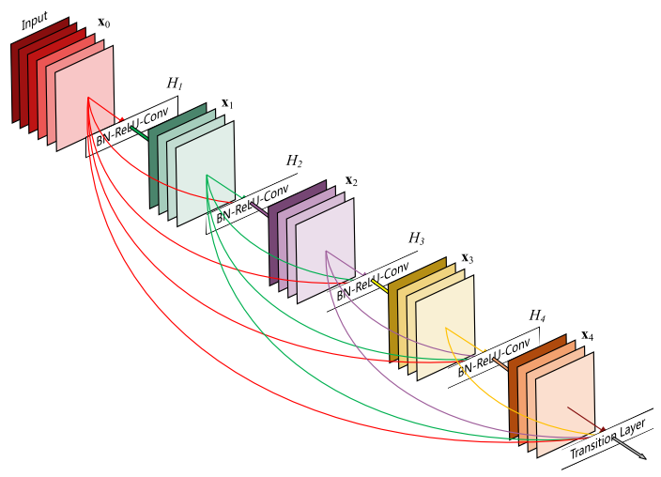
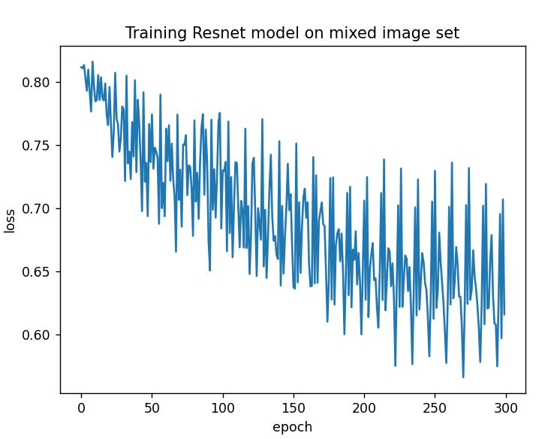
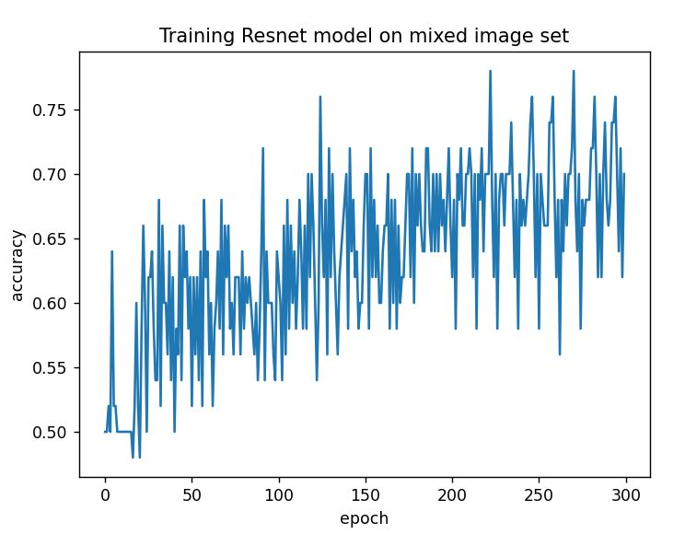
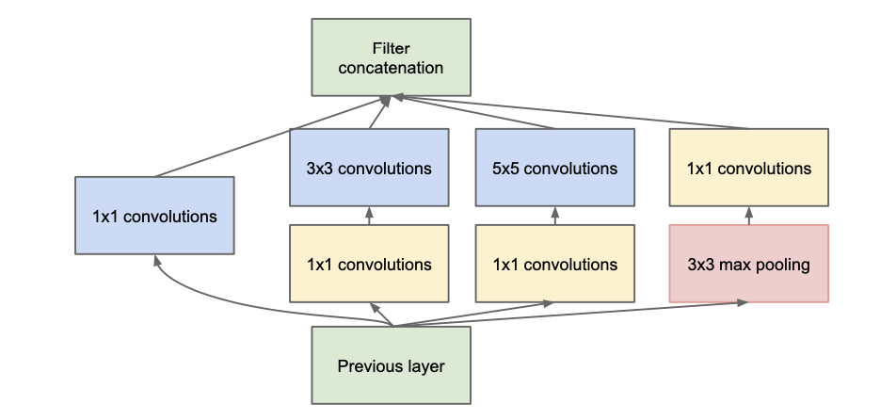
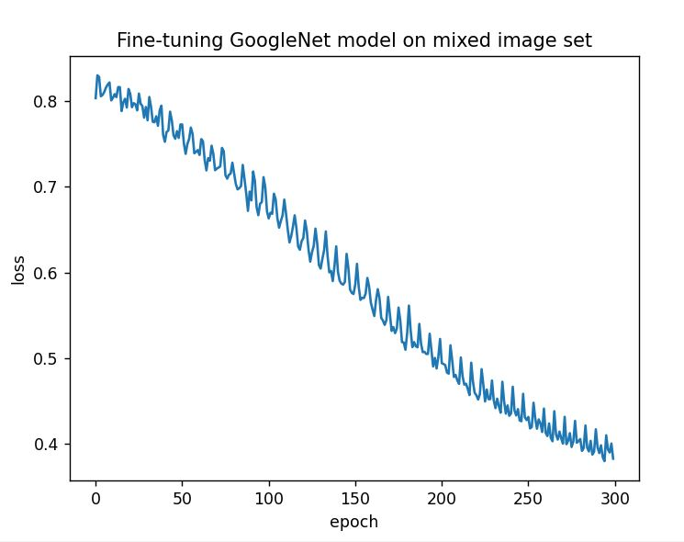
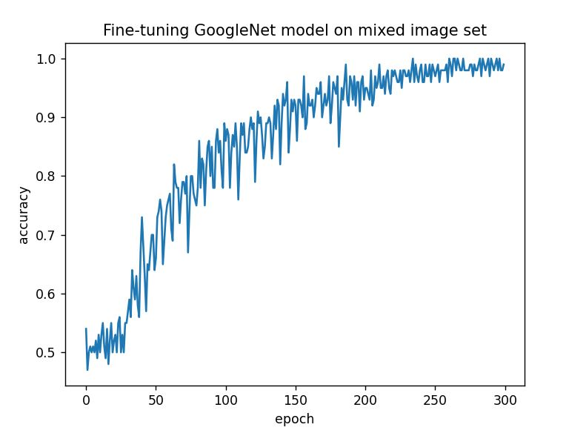
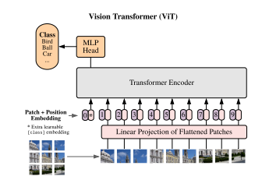
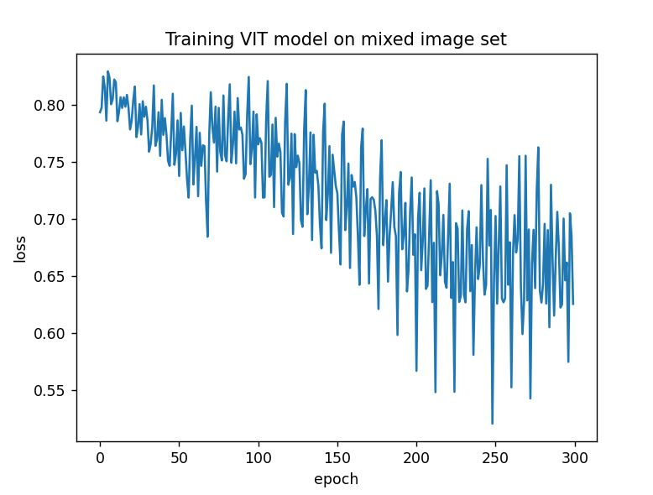
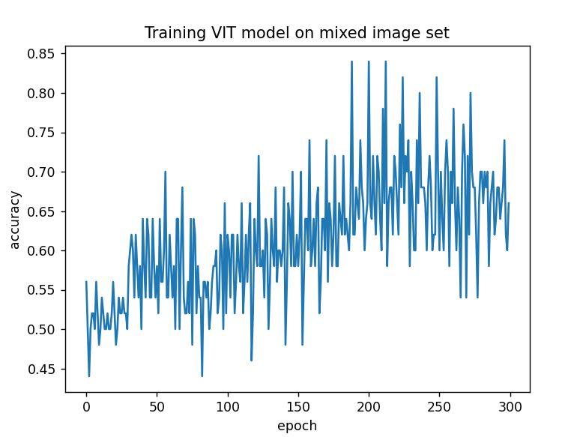

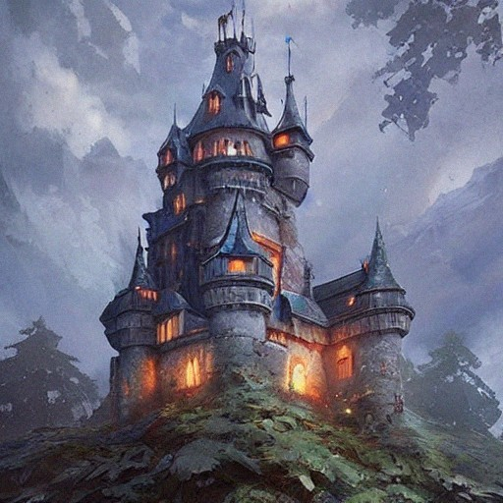
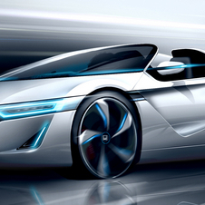
Deep Learning for Distinguishing AI Generated Images
Chuxuan Yin
Master of Computer Science
cy48@rice.edu
Motivation
Methods
Results
If we want to distinguish AI generated images, maybe neural network itself could be a better classifier than human being?
We’ll try to train three different models to complete this task: training a resnet50 model from scratch, fine-tuning pretrained GoogleNet model, using a fine-grained classification model called ViT
For hyper-parameters, we choose to train 300 epochs in batch-size 100, use cross-entropy loss function and SGD optimizer, set the learning rate 1e-3
Avatar
74%
Castle
66%
Car
70%
Mixed
72%
We might be not able to distinguish that…
resnet model
Large disturbance of loss, converged badly
Dataset
Conclusions
200 training and 100 testing images for three different kind of images separately
Mixed all these images together to make a big dataset
Each image is carefully selected, preprocessed to fit 200 * 200 dimension
Neural network could achieve more than 70% accuracy on this task after training, which means it could really distinguish AI generated image to a certain degree
Fine-tuning GoogleNet outperforms other models on all these dataset
Neural network perform best on avatar distinguishing(It may be affected by the quality of the dataset)
GoogleNet model
Tiny disturbance of loss, converged nicely
ViT model
Large disturbance of loss, converged badly
Avatar
Castle
Car
ViT model
Notes:
Download this template at http://peerrecognized.com/poster

